Slide 1
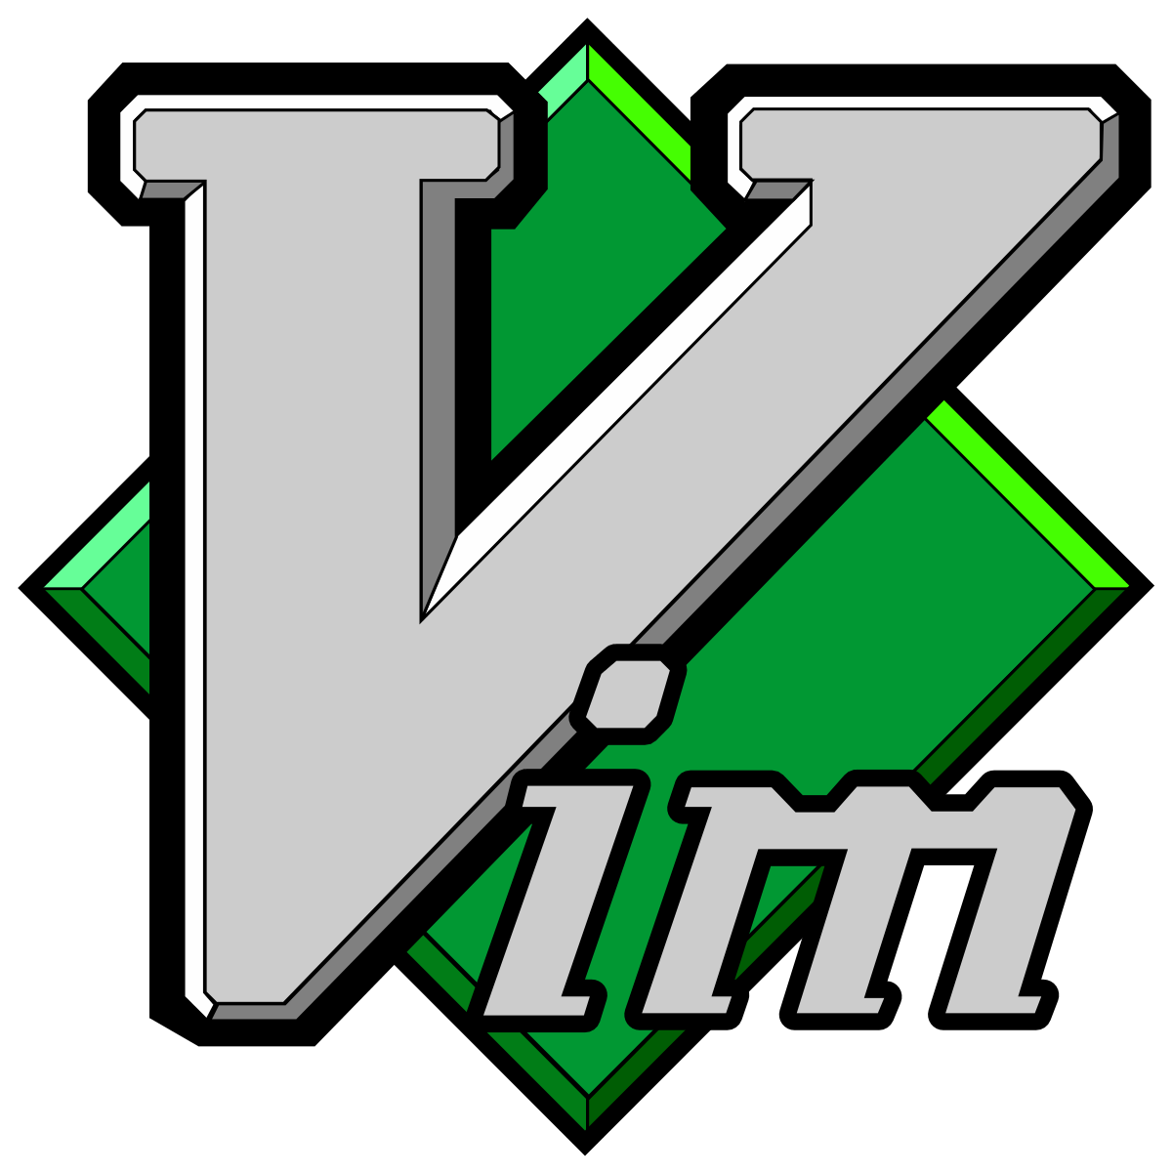
Introduction to the VIM editor
Vim VI-IMproved

Slide 2

History of VI and Vim
vi was created by Bill Joy of Sun Microsystems
vi Development started in 1976
vim is a clone of vi with many additions
vim was written by Bram Moolenar
Everything that is in vi is included in vim
Bill Joy of Sun Microsystems

Slide 3
Why should you know vim or vi?
Vi is present in almost every Linux Unix system, even the most minimal.
Vi/Vim is very powerful, as just a few very short commands can make sweeping changes to large documents. In fact, vi is more powerful than most of its users realize, and few of them know more than just fraction of all the commands

